Slide 1
Digital Image Processing
Associate Prof. Zhang Qingfeng(张庆丰)
Department of Computer Science, Jinan University
Office Room: 415, Nanhailou Building
Email: zqf135@qq.com, tqfz@jnu.edu.cn
1

Slide 2
Chapter 3
Intensity Transformations and Spatial Filtering (1)
2

Slide 3
Contents
Background
Some Basic Intensity Transformations Functions
Histogram Processing
Fundamentals of Spatial Filtering
Smoothing Spatial Filtering
Sharpening Spatial Filters
Combining Spatial Enhancement Methods
Summary
3

Slide 4
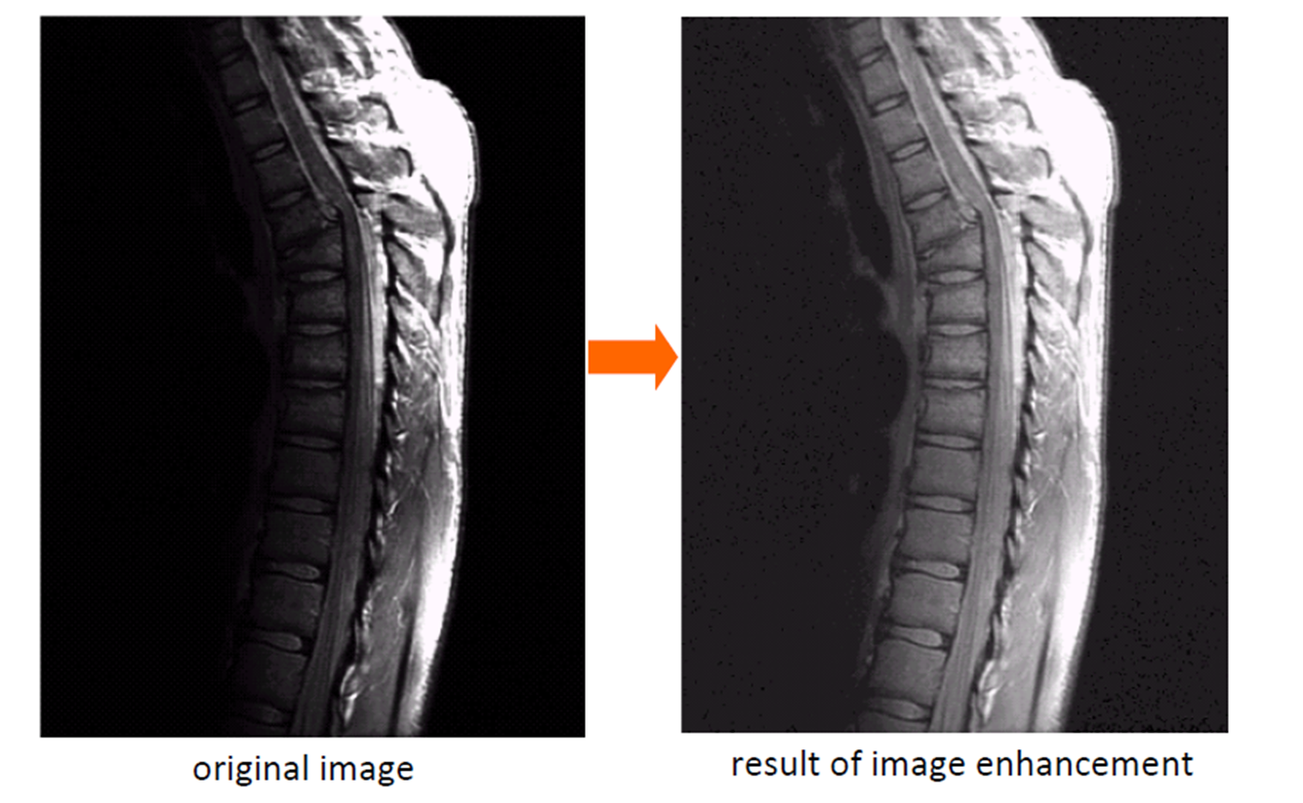
Background
Image enhancement is the process of making images more useful
The reasons for doing this include:
Highlighting interesting detail in images
Making images more visually appealing
Enhance otherwise hidden information
Filter important image features
Discard unimportant image features

Slide 5
Background
Spatial Domain
Refers to the image plane (the ‘natural’ image)
Direct image manipulation
Transform domain
People process the transform coefficients, not directly process the intensity values of the image plane
Two principal categories of spatial processing:
Intensity transformations
Spatial filtering.

Slide 6
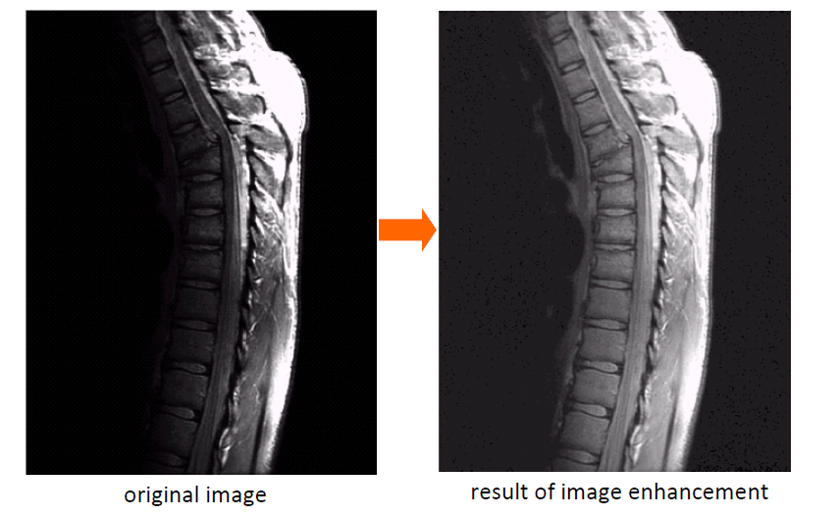
Several Examples for Image Enhancement

Slide 7
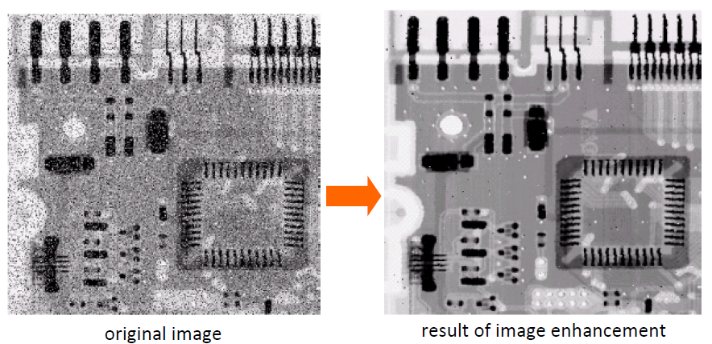
Several Examples for Image Enhancement

Slide 8
Background
Intensity transformation and spatial filtering in spatial domain can be denoted by:

Slide 9
Background
The operator can apply to a single image ( our focus in the chapter) or to a set of images, such as performing the pixel-pixel sum of a sequence of images for noise reduction.
A neighborhood about (x,y) is defined by using a square (or rectangular) subimage area centered at (x,y).

Slide 10
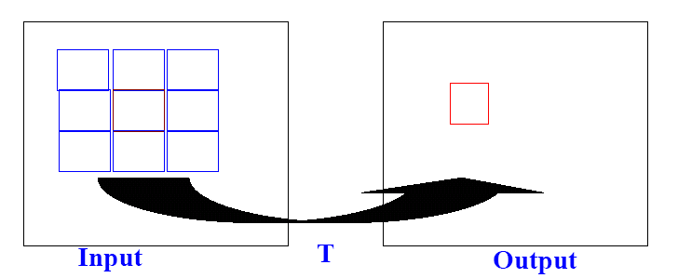
Background
Center of subimage is moved pixel by pixel. At each location (x,y), the operator T is applied to find the value of g(x,y).

Slide 11
Some Basic Intensity Transformations Functions
When the neighborhood is 1 x 1 then g depends only on the value of f at (x,y) and T becomes an intensity (also called gray-level or mapping) transformation function:
s=T(r)
r: denotes the gray level at any point (x,y) before processing.
s denotes the pixel intensity after processing.
This type of processing is called point processing.

Slide 12
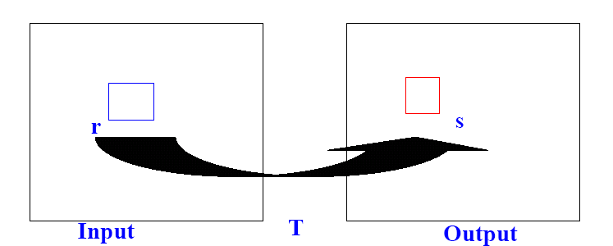
Point Processing
Simplest form of T : the neighborhood is 1x1.
g(x,y) depends only on the value of f at (x,y).
T: a gray-level transformation (mapping)

Slide 13
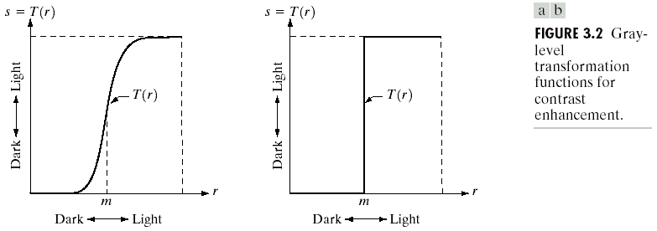
Point Processing
examples
Contrast Stretching
Thresholding

Slide 14
Some Basic Intensity Transformations
Image negatives
Log Transformations
Power-Law Transformations
Piecewise-Linear Transformation Functions:
Contrast stretching
Gray-level slicing
Bit-plane slicing

Slide 15
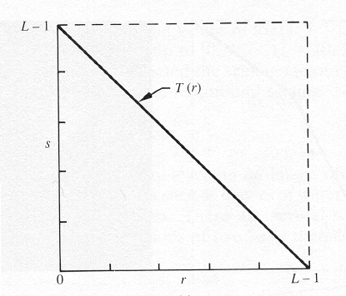
Image Negatives
The negative of an image with gray levels in the range [0,L-1] is obtained by the expression:
S= L-1-r

Slide 16
Image Negatives
Function reverses the order from black to white so that the intensity of the output image decreases as the intensity of the input increases.
Used mainly in medical images and to produce slides of the screen.

Slide 17
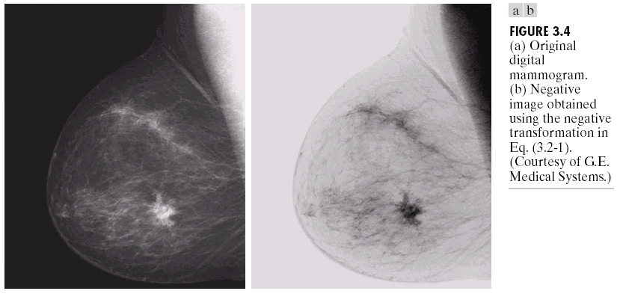
Example

Slide 18
Log Transformations
s = c log(1+r) where c is constant
Log transformation: maps a narrow range of low gray-level values in the input image into a wider range of output levels.
The opposite is true for higher values of input levels.
Expand the values of dark pixels in an image while compressing the higher-level values.

Slide 19
Log transformation
Log transformation has the important property of compressing the dynamic range of images with large variations in pixel values.
Compression of dynamic range: Sometimes the dynamic range exceeds capability of the display device. An effective way to compress the dynamic range of pixel values is
s = c log(1+r)

Slide 20
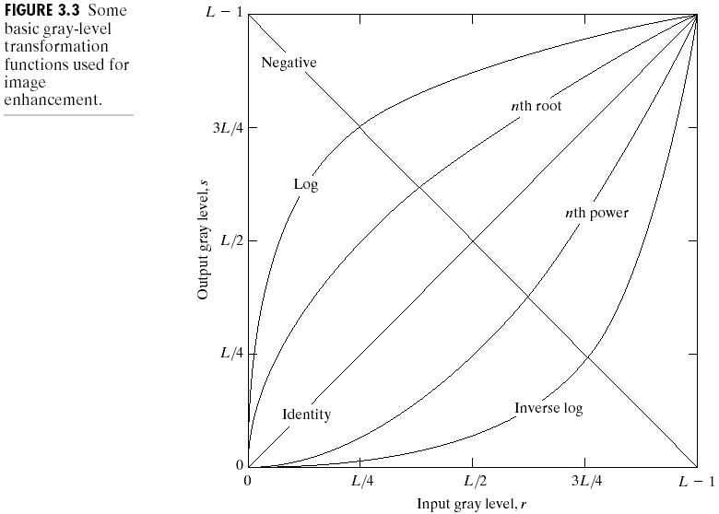
Illustration
Linear: Negative, Identity
Logarithmic: Log, Inverse Log
Power-Law: nth power, nth root

Slide 21
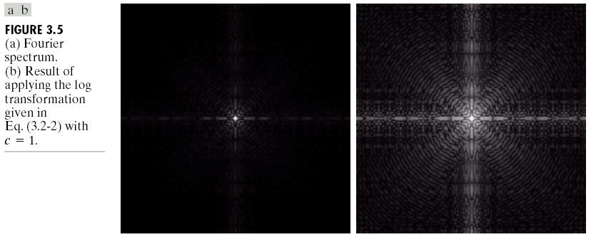
Example
From the range 0- to the range 0 to 6.2

Slide 22
Power-Law Transformations
C, γ : positive constants
If γ <1: transformation maps a narrow range of dark input values into a wider range of output values.
If γ >1:opposite of the above effect

Slide 23
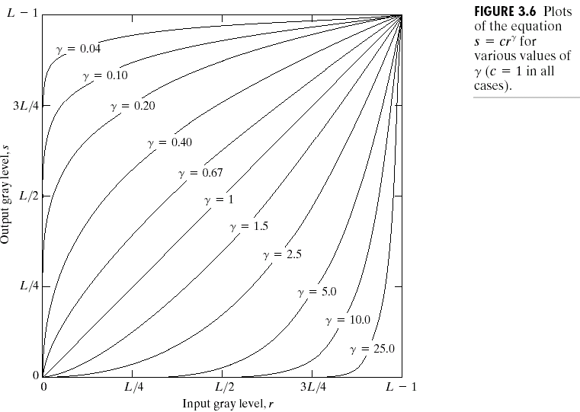
Illustration
γ=c=1: identity

Slide 24
Gamma correction
Many devices used for image capture, printing and display respond according to a power low.
The process used to correct this power-low response phenomena is called gamma correction.
Exp: CRT devices, γ=1.8 to 2.5
– The output of CRT is a darker image

Slide 25
Gamma Correction Illustration

Slide 26
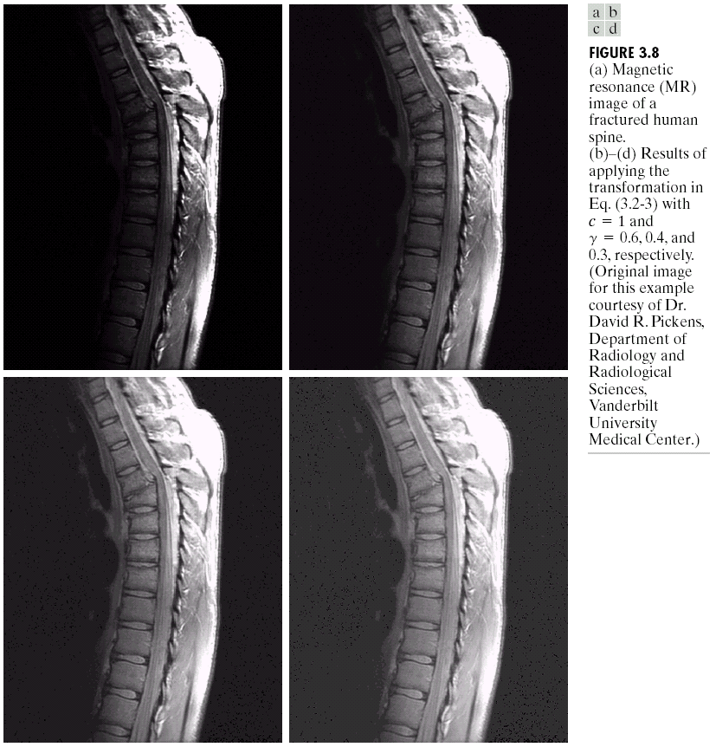
An example of power-law transformation for general purpose contrast manipulation

Slide 27
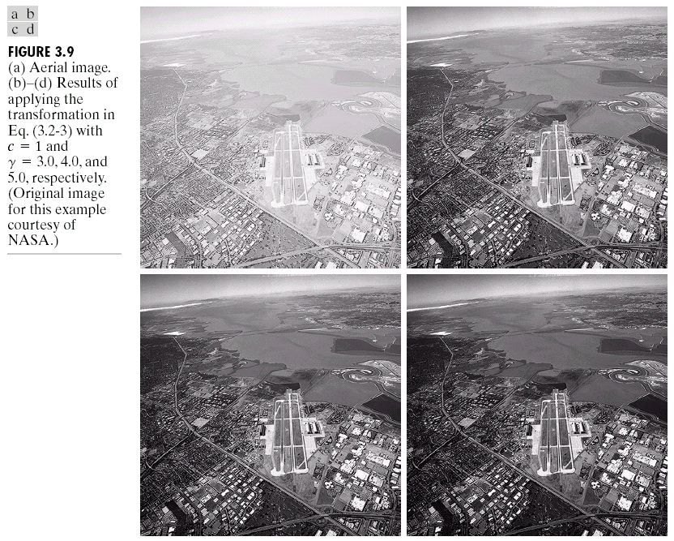
Another example of power-law transformation for general purpose contrast manipulation

Slide 28
Piecewise-Linear Transformation Functions
The advantage of piecewise-linear functions is that its form can be arbitrarily complex; the disadvantage is that their specification requires more user input
Three usually used piecewise-linear transformations
Contrast stretching
Intensity-level slicing
Bit-plane slicing

Slide 29
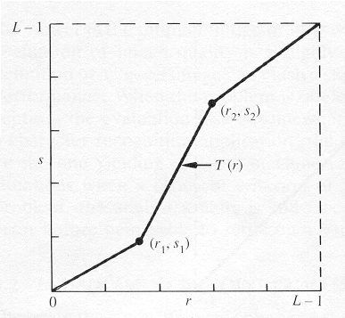
Piecewise-Linear Transformation Functions
Contrast Stretching
To increase the dynamic range of the gray levels in the image being processed.

Slide 30
Shape of the PLT function
Controlled by the locations of (r₁,s₁) and (r₂,s₂).
Intermediate values of (r₁,s₁) and (r₂,s₂) produce various degrees of spread in the gray levels of the output image, thus affecting its contrast.
Generally, r₁≤r₂ and s₁≤s₂ is assumed.

Slide 31
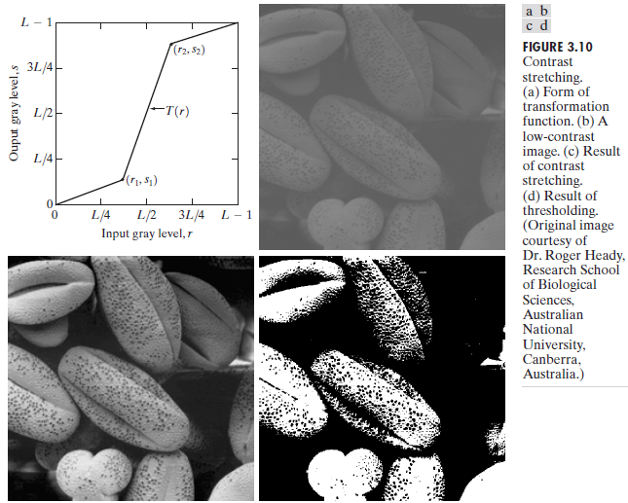
(b) a low-contrast image : result from poor illumination, lack of
dynamic range in the imaging sensor, or even wrong setting of a lens aperture of image acquisition
(c) result of contrast stretching: (r₁,s₁) = (r_{min},0) and (r₂,s₂) =(r_{max}, L-1)
(d) result of thresholding

Slide 32
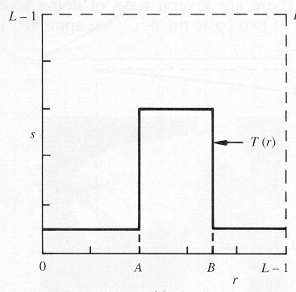
Intensity-Level Slicing
To highlight a specific range of gray levels in an image (e.g. to enhance certain features).
One way is to display a
high value for all gray
levels in the range of
interest and a low value
for all other gray levels
(binary image).

Slide 33
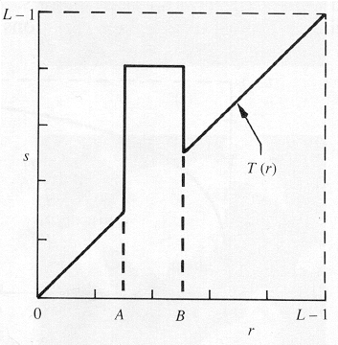
Gray-Level Slicing
The second approach is to brighten the desired range of gray levels but preserve the background and gray-level tonalities in the image:

Slide 34
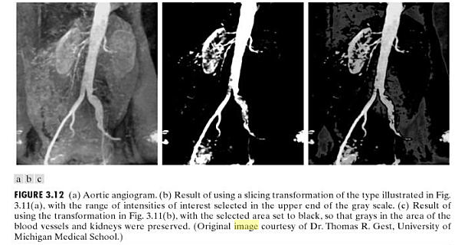
Example

Slide 35
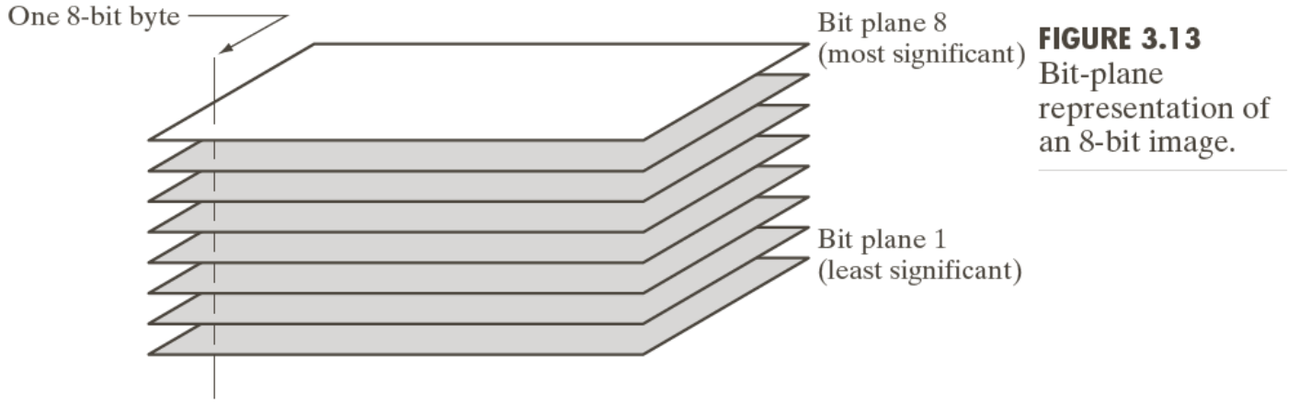
Bit-Plane Slicing
To highlight the contribution made to the total image appearance by specific bits.
i.e. Assuming that each pixel is represented by 8 bits, the image is composed of 8 1-bit planes.

Slide 36
Bit-Plane
Plane 1 contains the lowest-order (least significant) bit of all pixels and plane 8 the highest-order (most significant) bit.

Slide 37
Bit planes
Given an X-bit per pixel image, slicing the image at different planes (bit-planes) plays an important role in image processing.
Bit 1 is the least significant bit (LSB) and 8 is the most significant bit (MSB)
Only the higher order bits (top four) contain visually significant data. The other bit planes contribute the more subtle details.
Plane 8 corresponds exactly with an image thresholded at gray level 128.

Slide 38
Bit planes
An application of this technique is data compression.
In general, 8-bit per pixel images are processed.

Slide 39
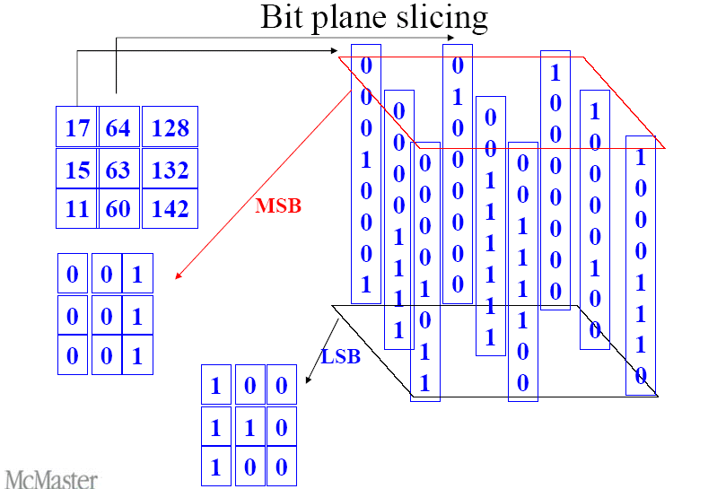

Slide 40
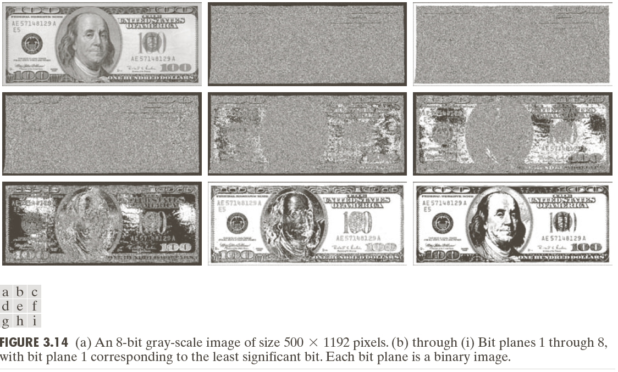
Original 8-bit image Lowest-order bit
Highest-order bit

Slide 41
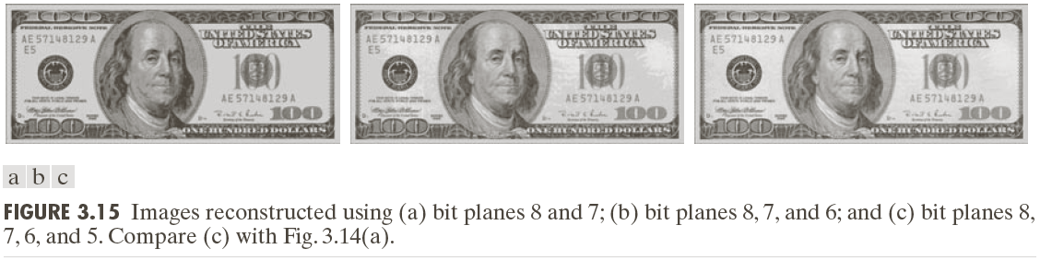

Slide 42
Histogram(直方图)
Statistics of the pixel gray-levels of an image
no. of occurrence
gray level

Slide 43
Histogram Processing
Histogram of a digital image with gray levels in the range [0,L-1] is a discrete function
h(r_{k}) = n_{k}
r_{k} : the kth gray level,
n_{k} : the number of pixels in the image having gray level r_{k}
h(r_{k}) : histogram of a digital image with gray levels r_{k}

Slide 44
Histogram Processing
Normalized histogram（规一化直方图）: dividing each of histogram at gray level r_{k} by the total number of pixels in the image, n
p(r_{k})=n_{k}/n
For k = 0,1,…,L-1,
p(r_{k}) gives an estimate of the probability of occurrence of gray level r_{k}
The sum of all components of a normalized histogram is equal to 1.

Slide 45
Histogram Processing
Histogram is the basic for numerous spatial domain processing techniques
Histogram is used effectively for image enhancement
Information inherent in histograms also is useful in image compression and segmentation

Slide 46
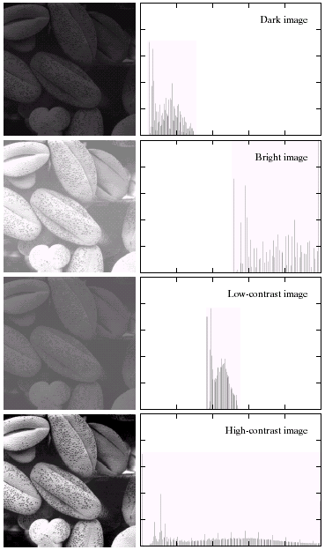
Dark image:
Components of histogram are
concentrated on the low side of the gray scale.
Bright image:
Components of histogram are
concentrated on the high side of the gray scale.
Low-contrast image
histogram is narrow and centered toward the middle of the gray scale
High-contrast image:
histogram covers broad range of the gray scale and the distribution of pixels is not too far from uniform, with very few vertical lines being much higher than the others

Slide 47
Histogram Processing
Histogram provides a global description of the appearance of an image:
– In a dark image, histogram is centered in the dark side of gray scale
– In a bright image, the histogram is biased toward the high side of gray levels
An image whose pixels occupy the entire range of possible gray levels and is uniformly distributed will appear as high-contrast.

Slide 48
Histogram Processing
The shape of the histogram of an image does provide useful info about the possibility for contrast enhancement.
Types of processing:
Histogram equalization
Histogram matching (specification)
Local enhancement

Slide 49
Histogram Equalization（直方图均衡化）
As the low-contrast image’s histogram is narrow and centered toward the middle of the gray scale, if we distribute the histogram to a wider range the quality of the image will be improved.
We can do it by adjusting the probability density function of the original histogram of the image so that the probability spread equally

Slide 50
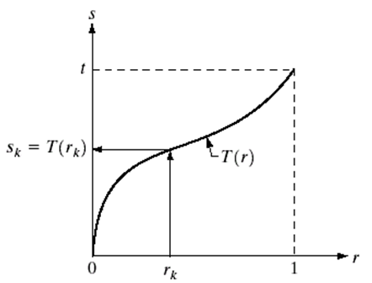
Histogram Equalization
s = T(r)
Where 0 ≤ r ≤ 1
T(r) satisfies
(a). T(r) is single valued and monotonically increasingly（单调递增） in the interval 0 ≤ r ≤ 1
(b). 0 ≤ T(r) ≤ 1 for 0 ≤ r ≤ 1

Slide 51
Histogram Equalization
Single-valued (one-to-one relationship) guarantees that the inverse transformation will exist
Monotonicity condition preserves the increasing order from black to white in the output image thus it won’t cause a negative image
0 ≤ T(r) ≤ 1 for 0 ≤ r ≤ 1 guarantees that the output gray levels will be in the same range as the input levels.
The inverse transformation from s back to r is
r = T ⁻¹(s) ; 0 ≤ s ≤ 1

Slide 52
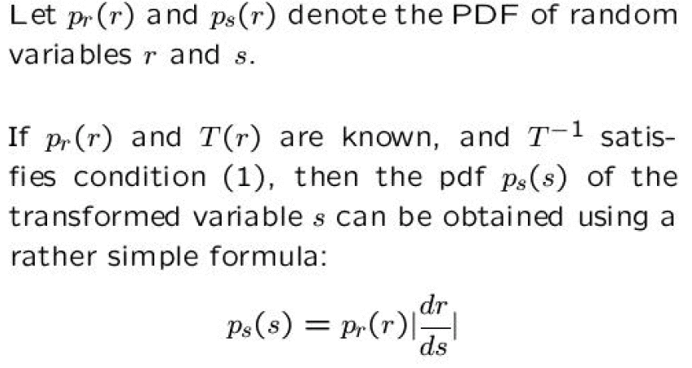
Continuous Transformation

Slide 53
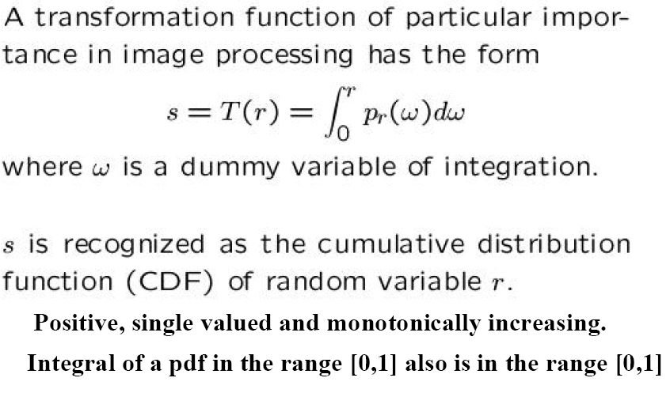
A transformation function

Slide 54
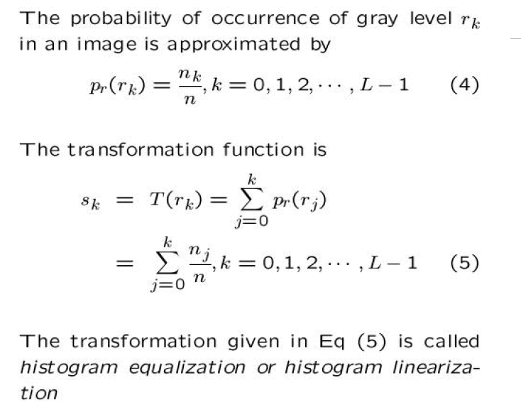
Discrete Version

Slide 55
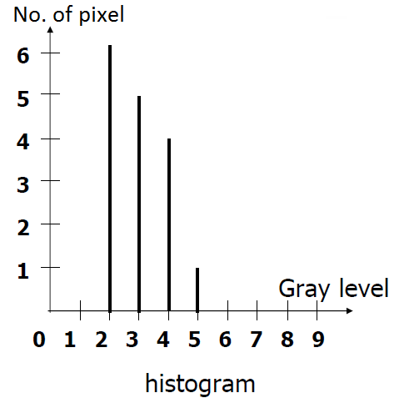
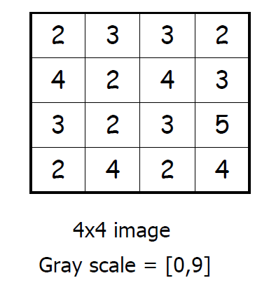
Example 1 of histogram equalization

Slide 56
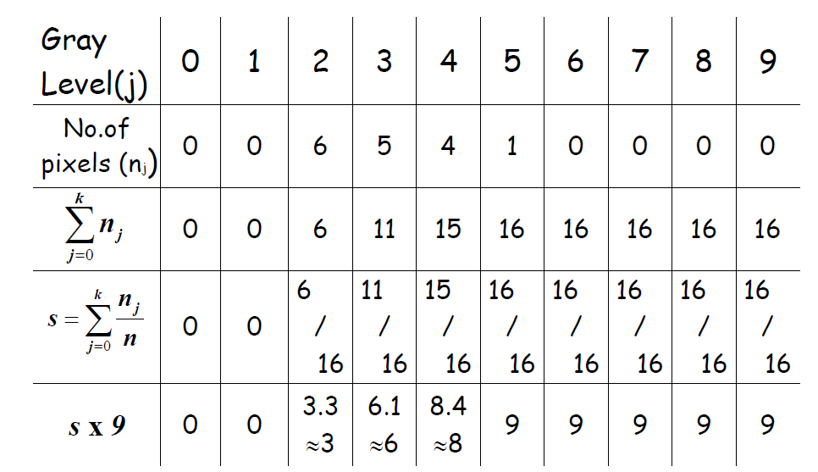
Example 1 of histogram equalization

Slide 57
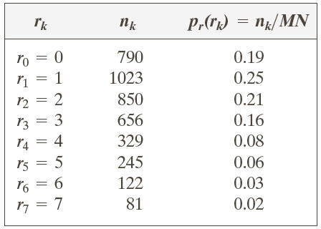
Example 2 of histogram equalization
Suppose that a 3-bit image (L=8) of size 64 × 64 pixels (MN = 4096) has the intensity distribution shown in following table.
Get the histogram equalization transformation function and give the p_{s}(s_{k}) for each s_{k}.

Slide 58
Example 2

Slide 59
Example 2 of histogram equalization

Slide 60
Note
It is clearly seen that
Histogram equalization distributes the gray level to reach the maximum gray level (white) because the cumulative distribution function equals 1 when 0 ≤ r ≤ L-1
If the cumulative numbers of gray levels are slightly different, they will be mapped to little different or same gray levels as we may have to approximate the processed gray level of the output image to integer number
Thus the discrete transformation function can’t guarantee the one to one mapping relationship

Slide 61
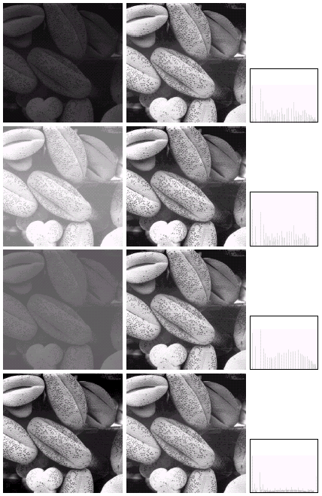

Slide 62
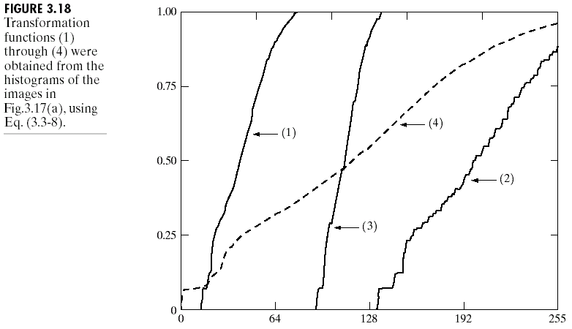
Transformation Functions

Slide 63
Histogram Matching (or Specification) 直方图规定化
Histogram equalization does not allow interactive image enhancement and generates only one result: an approximation to a uniform histogram.
In some cases, the enhancement based on a uniform histogram is not the best approach.

Slide 64
histogram Matching
It is useful sometimes to be able to specify the shape of the histogram that we wish the processed image to have.
The method used to generate a processed image that has a specified histogram is called histogram matching or histogram specification.

Slide 65
Histogram Matching
The procedure for histogram-specification based enhancement is:
(1)Equalize the levels of the original image using:
Where
n: total number of pixels,
n_{j}: number of pixels with gray level r_{j},
L: number of discrete gray levels.

Slide 66
Histogram Matching
(2)Specify the desired density function and obtain the transformation function G(z):
(3)Apply the inverse transformation function
z=G⁻¹(s) to the levels obtained in step 1.
pz: specified desirable PDF for output

Slide 67
Histogram Matching
The new, processed version of the original image consists of gray levels characterized by the specified density p_{z}(z).
In essence:

Slide 68
Histogram Matching
The principal difficulty in applying the histogram specification method to image enhancement lies in being able to construct a meaningful histogram. So…
Either a particular probability density function (such as a Gaussian density) is specified and then a histogram is formed by digitizing the given function,
Or a histogram shape is specified on a graphic device and then is fed into the processor executing the histogram specification algorithm.

Slide 69
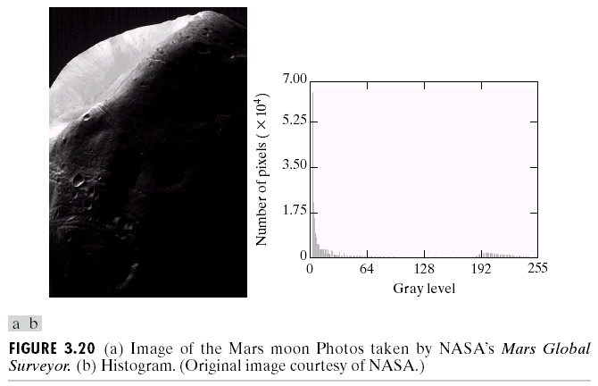
Example

Slide 70
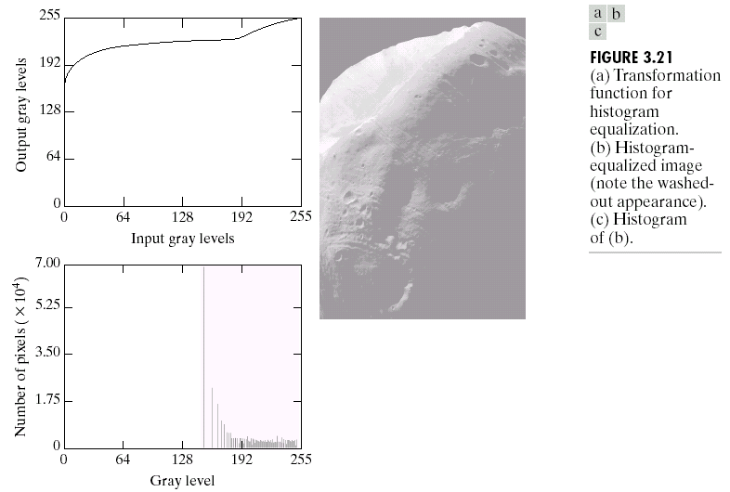
Example (cont.)

Slide 71
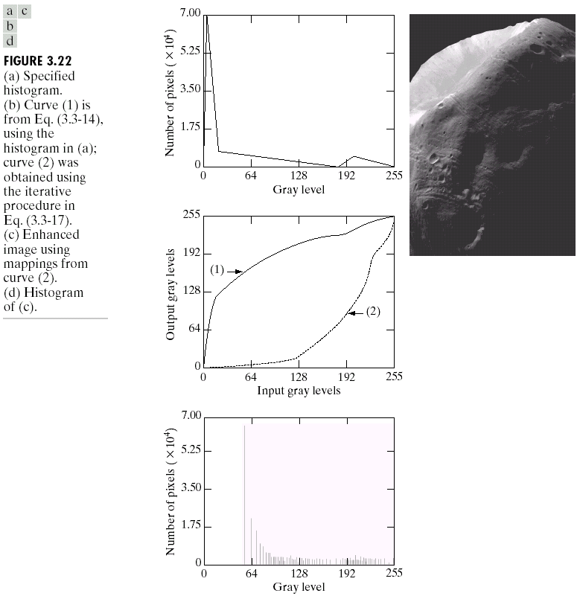

Slide 72
Local Enhancement
The above histogram processing methods discussed are global.
When it is necessary to enhance details over smaller areas in an image.
To devise transformation functions based on the gray-level distribution in the neighborhood of every pixel

Slide 73
Local Enhancement
Global
Histogram Enhancement，Histogram Matching
The gray-level content of an entire image
The number of pixels in these areas may have negligible influence on the computation of a global transformation.
Not guarantee the desired local enhancement.
Local
Based on neighborhood
Enhance details over small areas

Slide 74
The procedure of LE
Define a square (or rectangular) neighborhood and move the center of this area from pixel to pixel.
At each location, the histogram of the points in the neighborhood is computed and either a histogram equalization or histogram specification transformation function is obtained.
This function is finally used to map the gray level of the pixel centered in the neighborhood.
The center is then moved to an adjacent pixel location and the procedure is repeated.

Slide 75
Example

Slide 76
Use of histogram statistics for image enhancement
denotes a discrete random variable
denotes the normalized histogram component corresponding to the ith value of
Mean(均值)
Average intensity value of the entire image

Slide 77
Use of histogram statistics for image enhancement
The nth moment(n阶矩)
The second moment （二阶矩）

Slide 78
Use of histogram statistics for image enhancement
Global enhancement: The global mean and variance are measured over an entire image
Local enhancement: The local mean and variance are used as the basis for making changes

Slide 79
Use of histogram statistics for image enhancement
is the gray level at coordinates (s,t) in the neighborhood
is the neighborhood normalized histogram component
Local mean:
local variance (局部方差)

Slide 80
Use of histogram statistics for image enhancement
are specified parameters
is the global mean
is the global standard deviation (标准差)
Mapping

Slide 81
Use of histogram statistics for image enhancement

Slide 82
Summary
We have looked at:
Some basic intensity transformation functions
Histogram processing
82

Slide 83
Homework
Part 1
pp.215 problem: 3.1, 3.5
Part 2
The right graph shows An image of 5x4
pixels. The values in every cell represent
the gray level on the corresponding pixel.
The image’s gray scale is [0, 255]. Please
apply histogram equalization transformation
on the image and write down the results.
7 | 100 | 200 | 45
2 | 100 | 7 | 120
100 | 100 | 7 | 120
200 | 100 | 45 | 100
200 | 200 | 45 | 45
83

Slide 84
84

Slide 85
ANSWER: Normalized histogram
M
rows
7 | 100 | 200 | 45
2 | 100 | 7 | 120
100 | 100 | 7 | 120
200 | 100 | 45 | 100
200 | 200 | 45 | 45
An image of 5x5 pixels (M=?__4, N=?___5)
K=0,1,2,..,L-1=255.
L=256 levels
Sketch the histogram
N columns
Normalized Count
P(r_{k})=n_{k}/MN
level | count
2 | 1
7 | 3
45 | 4
100 | 6
120 | 2
200 | 4
1
Normalized histogram
0.5
0 100 200
Grad level(0-255) r_{k}

Slide 86
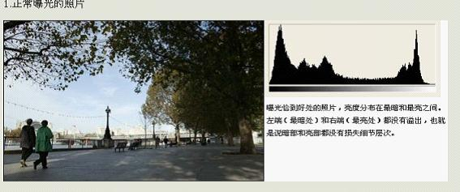
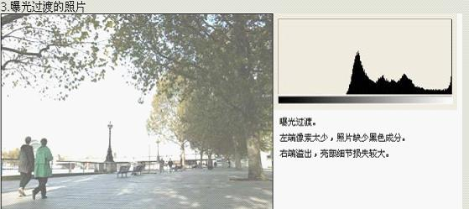
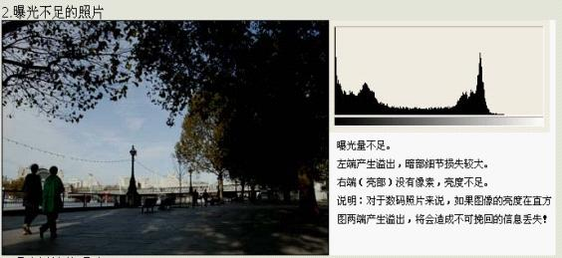
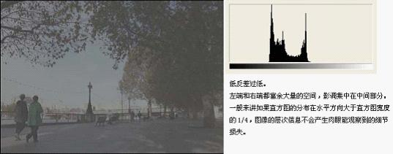
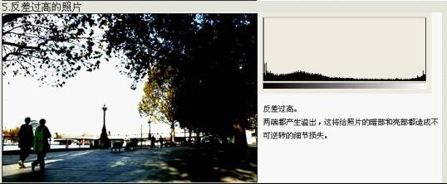
Application of histogram
86

